Slide 1

IoT
Industrial application
By –Abhishek Gautam (32113124)

Slide 2
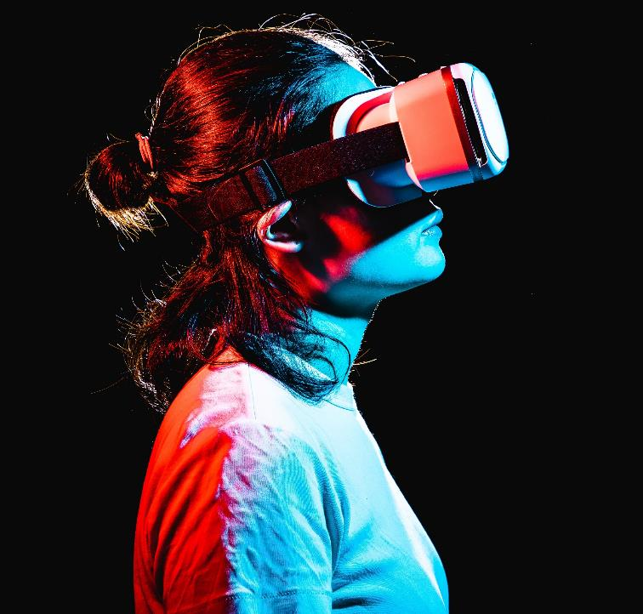
About
IoT is one of the fastest emerging technology in the current world scenario. In this session, we will focus on the Industrial application of IoT and its future scope.

Slide 3
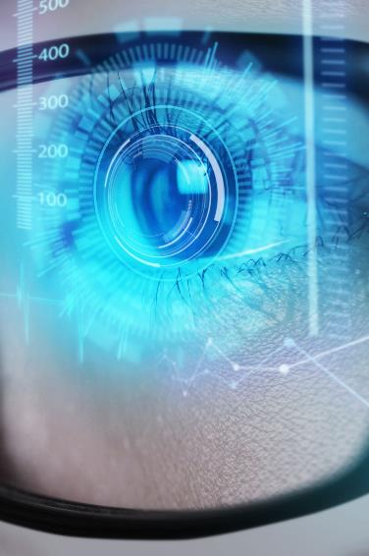
Focus Areas
Transportation
Smart Cities
Public Safety
Public safety in the twenty-first century requires real-time interactions between citizens, field personnel, law enforcement, intelligent sensors, and intelligent analytics
systems.
Purchases of task management software were up by $2 million in 2019
Loss of sales by not offering easier management tools that push teams to the finish line
Mining
10% increase in task management tools proves that there's consumer interest for more simple management tools and technology

Slide 4
Public Safety
Objective
Overview
The primary objectives of public safety organizations are to keep citizens, communities, and public spaces safe with faster response, improved operational efficiency, and
reduced costs.
A common theme across public safety is the need to collect, analyze, and distribute information to enable individuals, workgroups, supervisors, and executives to carry out
the missions of their respective agencies.
Cost savings
IoT Blueprint
IoT significantly reduces the cost of law enforcement by reducing the manpower to do so.
A simple product that gives businesses the information they need and capability to act on time

Slide 5
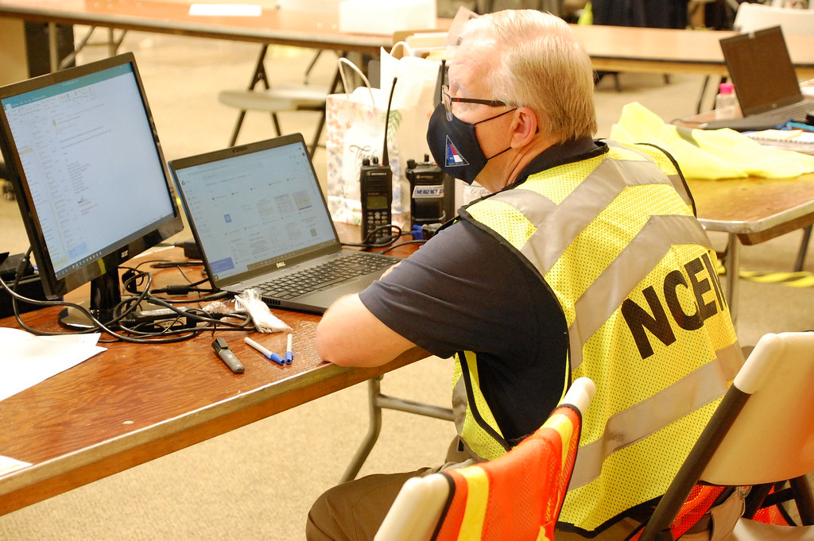
Iot role in Public safety
Public safety agencies—law enforcement, fire, EMS, and emergency management—have always been early adopters of the latest technologies, from the earliest telegraphic fire alarms to radios and dash cams. Today, expanding networks of smart devices and the rise of artificial intelligence are transforming public safety technology from an essential toolset into an autonomous partner that can act to help keep the public safe.

Slide 6

In Operation works
Smart streetlights
​With cameras, microphones, and sensors are using computer vision to gather intelligence about traffic, accidents, and crime. In a crisis, they can call for help and direct people to safety.
Smart intersections
Are capturing and analyzing traffic patterns, detecting risks, and warning against imminent accidents, reducing crashes and injuries.
Smart Buildings​
Are monitoring access, review video feeds, and running environmental systems. In an emergency, they can share camera feeds and building data with public safety officials.

Slide 7
Transportation
Objective
Overview
The primary objectives of IoT tech in the transportation industry is to make the autonomous, fast, and efficient transport system
IoT in Transportation is already a big business. Allied Market Research reported that the market was valued at $135 billion USD in 2016 and was expected to grow to $328 billion USD by 2023.
Cost savings
IoT Blueprint
IoT significantly reduces the cost of tolling and taxing on the public highways, tracking of cars, and providing emergency services.
A smart and efficient way to reduce risk and time consumption in the hugely decentralized industry.

Slide 8
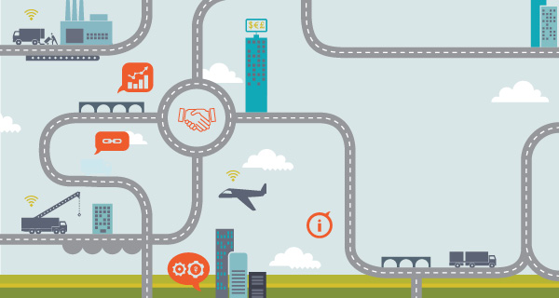
Iot role in Transportation
IoT for Transportation is a rapidly growing sector and the benefits of utilizing IoT technology are wide and varied. There are of course potential drawbacks to the use of IoT technology security is an issue that can’t be overlooked, with cyber-criminals targeting IoT devices. Adding more IoT devices to a network can increase the vulnerability of that network so security needs to be at the heart of any decision around the adoption of IoT technology.
This Photo by Unknown Author is licensed under CC BY-SA

Slide 9

In Operation works
Toll and Ticketing
Whilst automated tolls, using an RFID tag, have improved the flow of traffic, further improvements have been made possible by the use of IoT technology. A vehicle can be detected up to a kilometer away from a tolling station, correctly identified and the barrier lifted for the vehicle to pass through.
Vehicle Tracking Systems
Real-time vehicle tracking helps public transport agencies better communicate with customers and provide accurate arrival times through both mobile devices and passenger information displays at transit stops and stations
Highway emergency Services
Are monitoring access, review video feeds, and running environmental systems. In an emergency, they can share camera feeds and building data with public safety officials.

Slide 10

Benefits
Enhance Customer Experience
IoT technologies help to provide customers with more accurate, up-to-date, real-time data to better plan journeys and improve communication.
Improved Safety
The ability to track things such as train speeds, aircraft part conditions, roadway temperatures and the number of vehicles at an intersection using IoT-enabled technology can all help to improve the safety of our transit systems worldwide.
Operational Performance
Cities can better monitor critical infrastructures and develop efficient processes to minimize operating costs and improve system capacity.
Environmental Improvements
By better monitoring congestion, IoT-enabled systems can react quickly to evolving traffic patterns and return real-time data to help people to plan their journeys better. Reducing congestion and energy usage have a positive impact on the environment.

Slide 11
Mining Industry
Objective
Overview
In the mining industry, IoT is used as a means of achieving cost and productivity optimization, improving safety measures and developing their artificial intelligence needs.
Considering the numerous incentives it brings, many large mining companies are planning and evaluating ways to start their digital journey and digitalization in mining industry to manage day-to-day mining operations.
Economics
IoT Blueprint
Cost optimization & improved productivity through the implementation of sensors on mining equipment and systems that monitor the equipment and its performance. Mining companies are using these large chunks of data – 'big data' to discover more cost-efficient ways of running operations and also reduce overall operational downtime
The Internet of things (IoT) is the extension of Internet connectivity into physical devices and everyday objects. Embedded with electronics, Internet connectivity, and other forms of hardware; these devices can communicate and interact with others over the Internet, and they can be remotely monitored and controlled.

Slide 12
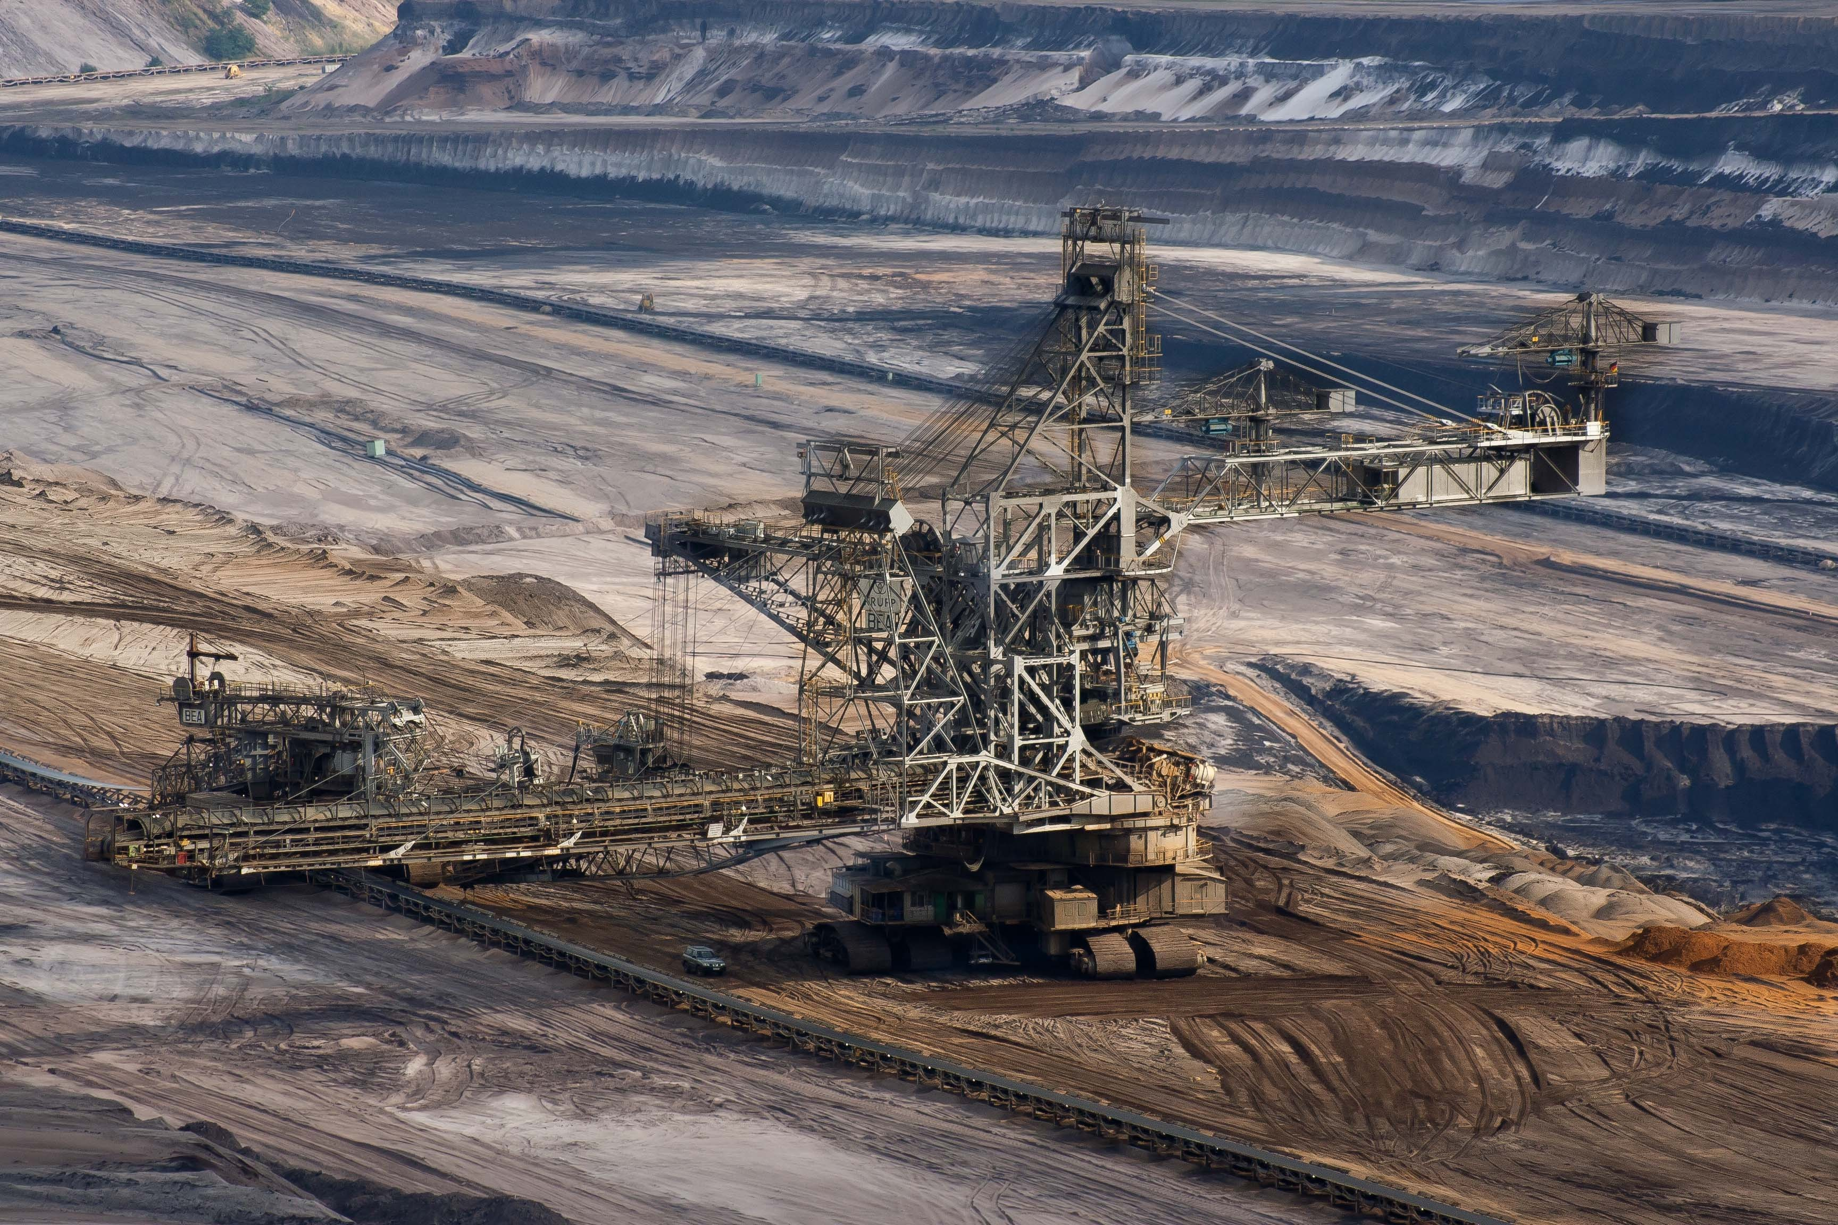
Iot role in Mining
The benefit of IoT in the mining industry is its role as the underlying system facilitating the use of Artificial Intelligence (AI). From exploration to processing and transportation, AI enhances the power of IoT solutions as a means of streamlining operations, reducing costs, and improving safety within the mining industry. Using vast amounts of data inputs, such as drilling reports and geological surveys, AI and machine learning can make predictions and provide recommendations on exploration, resulting in a more efficient process with higher-yield results.

Slide 13
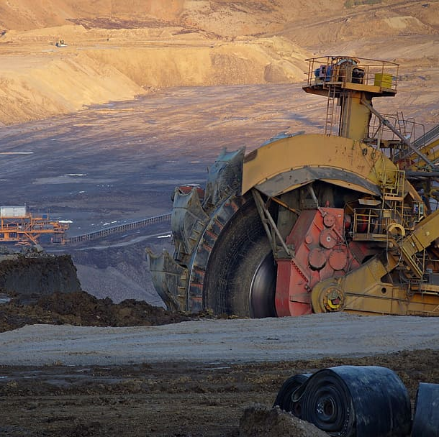
In Operation works
Rio Tinto - Koodaideri iron ore project - Australia
Rio Tinto's Kookaideri project in Australia is set to build the world's first "intelligent mine" where all assets are networked together and are capable of making decisions in microseconds. The mine planned to deliver the first ton of ore in 2021.
Hecla Mining Company -Casa Berardi mine - Canada
The mine introduced Newtrax's Mobile Equipment Telemetry in order to better manage machine downtime. With real-time equipment diagnostics, Hecla has been able to use data to determine optimal ways to utilize machines and make immediate diagnoses of equipment issues in order to decrease downtime.
​Hindustan Zinc’s Sindesar Khurd (SK) mine - India
Newtrax MET integrated with the Sandvik OptiMine digital platform to track and receive data from the entire underground operation including drills, loaders, trucks and other equipment.

Slide 14
Smart Cities
Objective
Overview
IoT has the potential to tame the pressure of urbanization, create new experience for city residents, and make day-to-day living more comfortable and secure.
IoT-enabled smart city use cases span multiple areas: from contributing to a healthier environment and improving traffic to enhancing public safety and optimizing street lighting.
Market
IoT Blueprint
IoT in Smart Cities Market worth $312.2 billion by 2026.
A smart and efficient way to reduce risk and time consumption in the hugely decentralized industry.

Slide 15
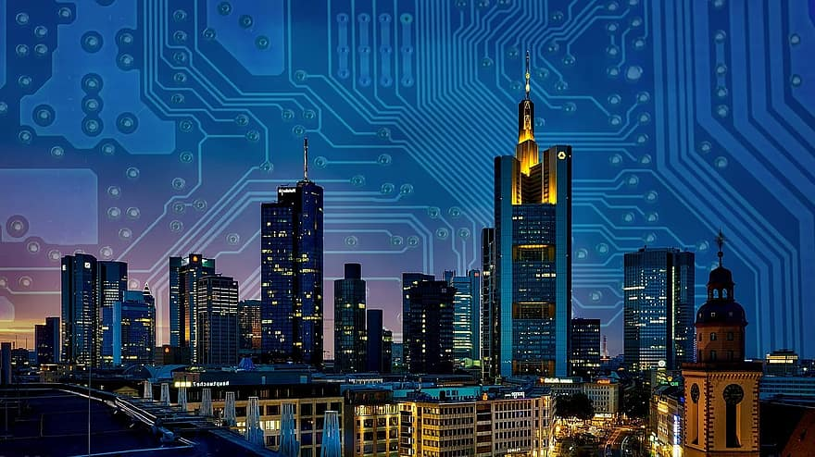
Iot role in Building Smart Cities
The new Internet of Things (IoT) applications is enabling Smart City initiatives worldwide. It provides the ability to remotely monitor, manage, and control devices, and to create new insights and actionable information from massive streams of real-time data. The main features of a smart city include a high degree of information technology integration and a comprehensive application of information resources.

Slide 16
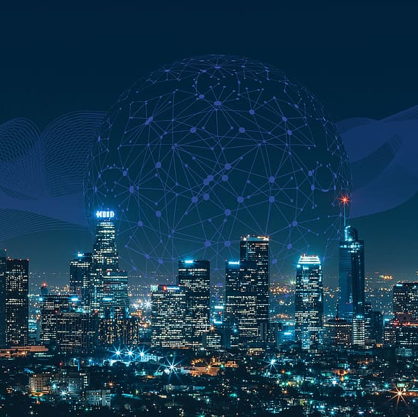
In Operation works
Smart Infrastructure
Digital technologies are becoming increasingly important for cities to have the conditions for continuous development; buildings and urban infrastructures must be planned more efficiently and sustainably.
Air Quality Management
Smart cities also are implementing tools that can capture pollution data in real-time and forecast emissions. Being able to predict air pollution accurately allows cities to get to the root of their emissions problems and brainstorm strategic ways to limit the amount of air pollution they put out.
​Smart Waste Management
Waste management solutions help to optimize the efficiency of waste collection and reduce operational costs while better addressing any and all environmental issues associated with inefficient waste collection.

Slide 17
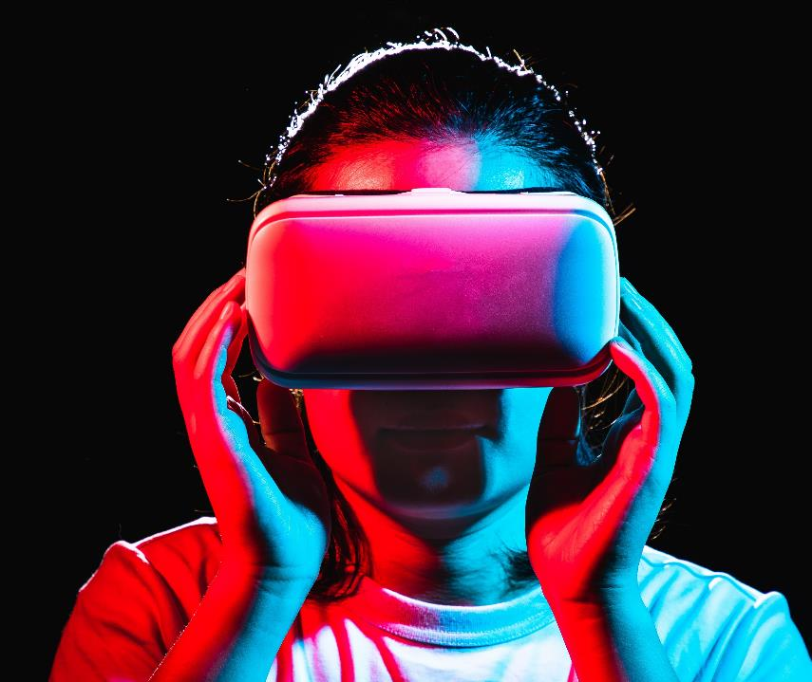
Thank you

